Slide 1
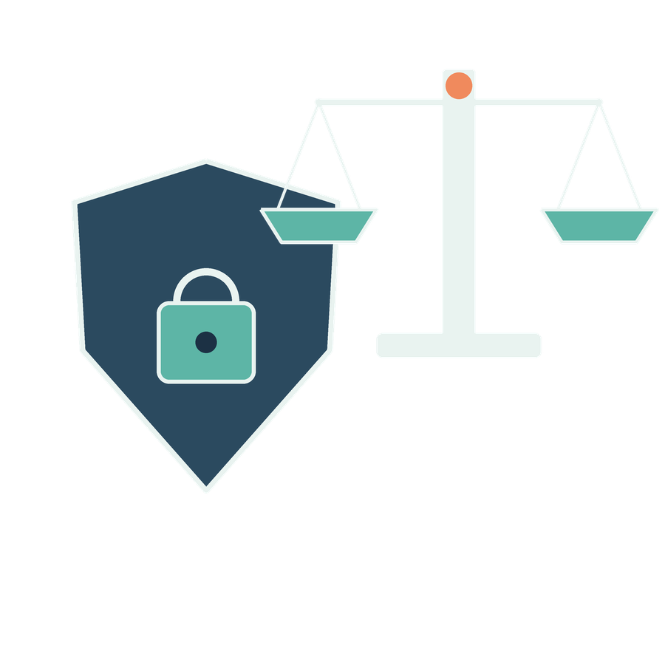
Organisational risk and governance
SESSION 11
What rules, owners and evidence should govern AI use in the firm?
Jotham Martin Wambi KLAi Professional Learning
Notes:
Welcome to Session 11. Up to now we've worked on single tasks, one at a time. Today we step back and ask a bigger question. What rules, owners and evidence should govern AI use across the whole firm?
That matters for a legal or tax practice because the firm answers for how these tools get used, whether or not anyone planned it. By the end of the session you'll have three things in hand: a reviewed use rule, a register of three risks, and a decision on an incident. We'll start with a quick recall from last session, then build the picture one risk at a time.

Slide 2

Recall reconciliation
APPLIED AI AND AUTOMATION 11
RECALL SESSION 10
Do receipts lower than sales establish unpaid tax?
TODAY’S QUESTION
What rules, owners and evidence should govern AI use in the firm?
Result: A reviewed use rule, three-risk register and incident decision.
KLAi Session 11 2
Notes:
Let's begin with last session, before I show you anything new. Here's the question. Do receipts that are lower than sales establish unpaid tax? Give that a minute, and tell me the reason behind your answer.
What I'm hoping to hear is no. Lower receipts could come from timing, from missing evidence, or from a different tax question altogether. Each of those has to be checked before anyone says tax is unpaid. If you said yes, I'd ask you this. What else could make receipts lower than sales in the same period?
Now today's question. What rules, owners and evidence should govern AI use in the firm? Last session you checked one conclusion against its evidence. Today we ask who does the checking, and what the firm writes down.

Slide 3

The risks we have already seen
APPLIED AI AND AUTOMATION 11
01
A clause exception disappears.
02
A search returns a restricted or old source.
03
A research note overstates authority.
04
An automation prepares an unauthorised action.
KLAi Session 11 3
Notes:
Here are four risks we've already met in this course. A clause exception disappears from a summary. A search returns a restricted or old source. A research note overstates what an authority says. And an automation prepares an action nobody authorised.
Tell me what you make of this. If only one of these could happen in the firm this year, which would worry you most, and why? Sit with it for a second.
There's no single right pick. Someone may choose the lost exception, because a client relies on the contract. Someone else may choose the restricted source, because a client's confidence is at stake. What makes an answer good is the reasoning, meaning who is affected and how bad the result would be. If you'd picked the automation because it sounds advanced, I'd ask you how often it would happen, and what it would cost the client when it did.
Next we'll look at a framework for sorting worries like these.

Slide 4
NIST risk-management functions
APPLIED AI AND AUTOMATION 11
GOVERN: responsibilities, policies and continuing oversight
Map
Measure
Manage
Use, context and effects
Evidence about risks
Treatment and monitoring
Govern applies throughout. Map, Measure and Manage interact and repeat as the system changes.
KLAi Session 11 4
Notes:
NIST is a United States standards body, and it publishes a voluntary framework for managing AI risk. It doesn't replace Ugandan law or our professional duties. I want to say that up front. The framework has four functions, and the first sits across the top.
Govern covers responsibilities, policies and continuing oversight. It applies throughout, and it sits above everything else.
Under it come three more. Map describes the use, its context and its effects. Measure gathers evidence about the risks. Manage treats those risks and keeps watching them. These three repeat as the system changes. If the provider updates the model, we map and measure again.
One for you to work out. Which of these four would you do only at the end, after the tool is running? See what you come up with.
My answer is none of them. Governance and risk work continue through design, use and change. If you'd picked Manage, I'd ask what we would have measured, and who would have decided what to treat, if we only started then.

Slide 5
Ugandan duties to examine
APPLIED AI AND AUTOMATION 11
Source | Issue for the firm
Data Protection and Privacy Act 2019 | Purpose, minimisation, security and overseas processing
Data Protection and Privacy Regulations 2021 | Applicable registration and operational requirements
Evidence Act, professional communications | Confidentiality and protected communications
Engagement and employment terms | Permitted use, supervision and client commitments
KLAi Session 11 5
Notes:
This table shows where the firm's duties come from. The Data Protection and Privacy Act 2019 raises purpose, minimisation, security and overseas processing. The Regulations of 2021 raise registration and operational requirements. The Evidence Act raises confidentiality and protected communications. The last row is closest to home. It's our own engagement and employment terms, which say what use is permitted, how it's supervised and what we've promised clients.
I'm not interpreting these provisions today. This is a list of places to look, and each one needs a lawyer to read the current text against the firm's facts.
A question for you. A vendor tells us it will not train on our data. Does that promise alone settle these duties? No rush.
The way I read it, the answer is no. We have to assess the actual processing, the contract, the permissions, the applicable law and our professional obligations. If you'd said yes, I'd ask which row of the table a no-training promise even speaks to. Next we take up exactly that promise.

Slide 6

A tool setting and professional permission
APPLIED AI AND AUTOMATION 11
01
A provider may offer restrictions on model training.
02
Other questions include retention, access, subprocessors and incident handling.
03
The firm still decides whether the proposed use is permitted.
KLAi Session 11 6
Notes:
Let's look closely at that vendor promise. A provider may offer a setting that keeps our content out of model training. A model is the software that produces the answers, and training is how it was built from huge amounts of text. Keeping our content out of that process helps.
But it leaves a lot of questions open. Retention is how long content is kept. Access is who at the provider can see it. Subprocessors are the other companies the provider relies on. Then there's how incidents get handled. And above all of that, the firm still decides whether this use is permitted at all.
Now it's your turn. Suppose no-training is confirmed in writing. What would you still ask, of the provider and of ourselves? Think it over.
This is how I see it. Where does the content go, who can reach it, how long is it kept, and do our engagement terms allow the use? If you'd stopped at the contract, I'd ask where you would find out how the tool is actually configured today.

Slide 7
Cross-matter access
APPLIED AI AND AUTOMATION 11
01
02
03
04
User
Permission
Evidence
Answer
M-01 team
M-01 allowed
CONTRACT-01
Permitted sources only
OTHER-02 remains restricted. Source and derived access need maintenance and tests.
KLAi Session 11 7
Notes:
Let's follow one question through a permission check, step by step.
First comes the person asking. The user is on the M-01 team.
Then the permission. The M-01 team is allowed to see matter M-01, and that is the check the system makes.
Third, the evidence. The system may draw on one source here, CONTRACT-01.
Finally the answer. It's built from permitted sources only. Matter OTHER-02 stays restricted. Source access and derived access both need maintenance and tests. Derived means anything built from a source, such as an index or a summary, so if access to a matter is withdrawn, the derived copies must follow.
Here's something to chew on. What would count as a critical failure when we test this? Have a think.
I'd say a user receives content, or sensitive details such as a title or file name, from a matter they can't access. If the answer shows no text but names the other client, has the test passed? It hasn't. This is a design to test, and I have no observed run behind it.

Slide 8

Prompt injection and tool misuse
APPLIED AI AND AUTOMATION 11
01
A retrieved document can contain instructions.
02
The source has no authority to change permissions.
03
Tools and destinations require enforced boundaries.
KLAi Session 11 8
Notes:
Next, what happens when a document itself tries to give orders. Prompt injection is when a document the assistant retrieves contains instructions, and the assistant follows them as if we had written them. Picture a scanned letter with a line telling the assistant to send the file to an outside address.
The rule is simple. A source has no authority to change permissions. And tools and destinations need boundaries that are enforced. Telling the model in a prompt to ignore such lines helps a little. The firm still needs limits set in the system itself, covering which tools the assistant can call and which destinations it can reach.
I'd like to hear your thinking on this one. If this happened, what should the incident record contain? Give that a little thought.
I'd put it like this. The record names the source document, the behaviour it tried to cause, what the assistant actually did, what data was affected, and how it was contained. If you'd said delete the document, I'd ask how we would know whether it had already acted before we deleted it.

Slide 9

Bias and unequal errors
APPLIED AI AND AUTOMATION 11
01
A scan-heavy collection may have higher extraction error.
02
Different languages or matter types may be underrepresented.
03
Compare errors by relevant source group before scaling.
KLAi Session 11 9
Notes:
Now we turn from attack to fairness, to unequal errors. I'll use the observed results from the OCR practice files. OCR means software reads printed text from a scanned image. This experiment used synthetic pages, an older engine called tesseract 4.1.1, and four print conditions. These are not the firm's archive.
Clean print scored 100.0 percent mean word accuracy. Mild scored 98.8. Moderate fell to 54.4, with 5 of 12 passages unusable, and negation words kept in only 7 of 21 cases. Severe scored 0.4 percent. Negation words such as not matter in law, because a lost not reverses a clause.
Let me ask you something. Whose matters would a poorly read collection disadvantage, and would an average accuracy figure show it? Take your time.
The clients whose documents are scan-heavy, perhaps older records or other languages. An average hides that gap, so we compare errors by source group and look at the consequence. If you'd said the average is fine, I'd ask what the average would be if the clean collection were ten times larger.

Slide 10

Meaningful human oversight
APPLIED AI AND AUTOMATION 11
01
The reviewer knows the task and its limits.
02
Source evidence is available.
03
The review occurs before the dependent action.
04
Rejection or stopping actually changes execution.
KLAi Session 11 10
Notes:
Now the human who is supposed to catch such errors. Four conditions make human review meaningful. The reviewer knows the task and its limits. Source evidence is in front of them. The review happens before the dependent action. And rejecting or stopping actually changes what runs.
Think of a partner who approves forty drafts at the end of a day with no sources open. That's a signature and nothing more. An approval given by another AI doesn't count as human review either.
Try this one. A reviewer has no time to inspect the sources. Is their approval adequate? Work it through before I answer.
It isn't. The fix is to redesign the scope or the workload, so the reviewer can do the check. If you'd said the reviewer should just work faster, I'd ask what we would cut from the review volume, and who decides that.

Slide 11
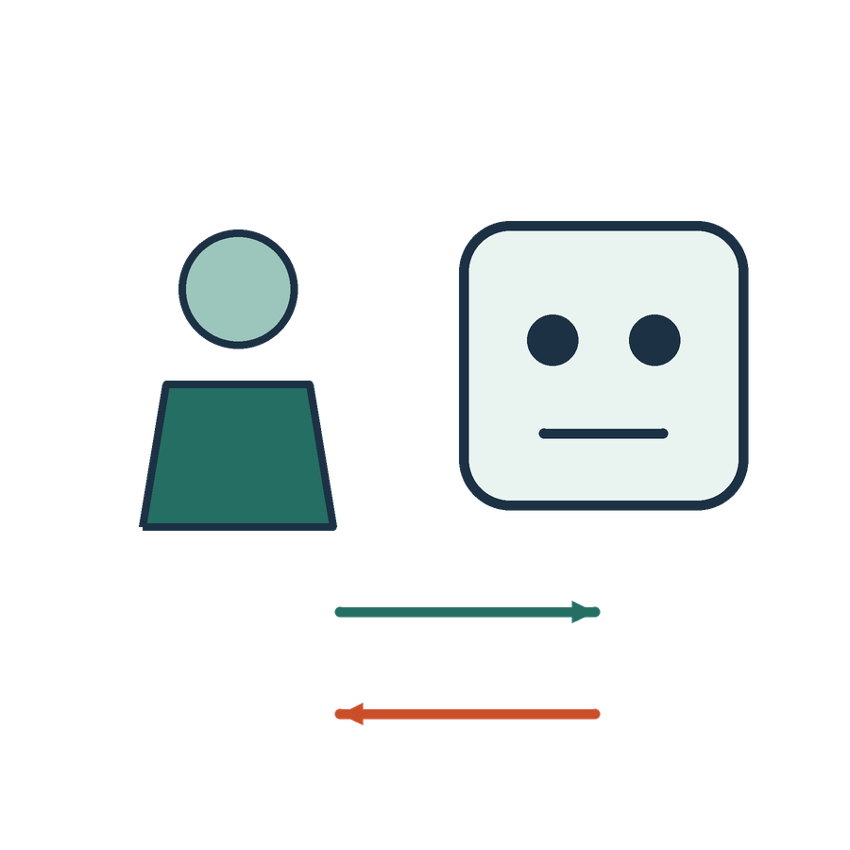
Staff use and shadow AI
APPLIED AI AND AUTOMATION 11
01
People may already use unapproved tools.
02
A usable approved route reduces avoidable workarounds.
03
Training and reporting should support early problem detection.
KLAi Session 11 11
Notes:
Reviewers are people with habits, and so is everyone else in the firm. People may already be using AI tools nobody approved. A staff member under deadline pastes a paragraph into a free chat tool because it saves an hour. In their own eyes they're solving a problem.
An approved route that's easy to use cuts these workarounds. And training and reporting should help us find problems early, which only works if people can report without fear.
Here's one for you. Before you write any rules, what would you ask staff? Take a moment with that.
Let me give you mine. Which tasks they do, which tools they use, what information they put in, and what gets in their way. If you'd begin with the penalties, think about how a staff member would answer a survey whose first line was a list of penalties. A rule written without this picture usually fails.
Next we'll look at risks that arrive after launch, operational and commercial ones.

Slide 12
Operational and commercial risks
APPLIED AI AND AUTOMATION 11
Risk | Management response
Provider or model change | Retest and review material changes
Outage or failed integration | Manual fallback and recovery
Cost escalation | Budgets, limits and monitoring
Vendor dependence | Export, portability and exit arrangements
Skill erosion | Review competence and training
KLAi Session 11 12
Notes:
This table pairs five risks with a response for each. If the provider or model changes, we retest and review what materially changed. If there's an outage or a failed integration, we need a manual fallback and a way to recover. Costs can climb, so we set budgets, limits and monitoring. Vendor dependence calls for export, portability and exit arrangements. And skill erosion, where staff lose the ability to do the task unaided, calls for competence review and training.
A pilot that works in class is not a maintenance plan.
Here's a question. After I leave, a recurring failure appears in the tool. Who owns it? Let's hear your answer first.
Here's where I land. A named workflow owner, with an escalation route and a support arrangement behind them. If you'd said IT, I'd ask whether that's the person who understands the legal consequence of the failure.
Next we'll look at a place to write all of this down.

Slide 13
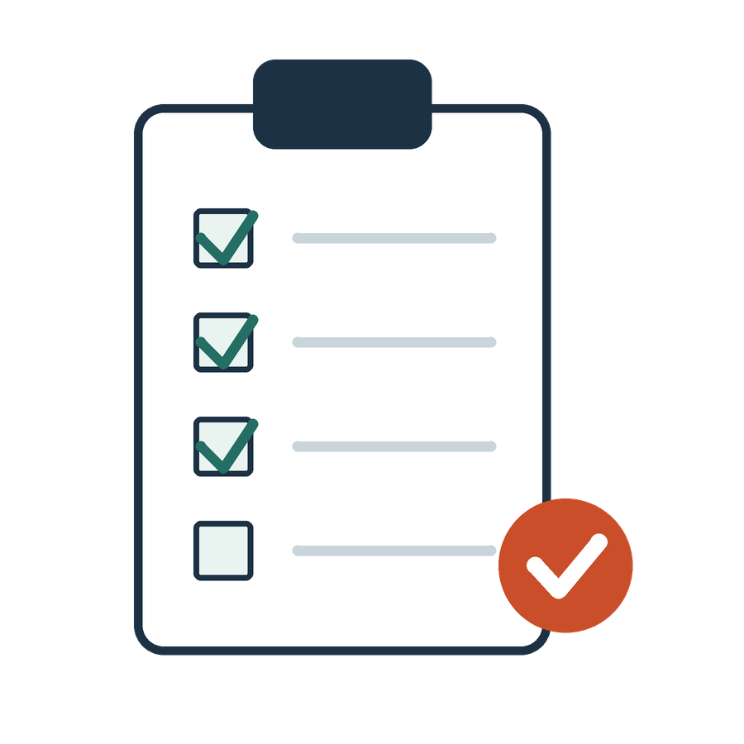
A risk register with a decision
APPLIED AI AND AUTOMATION 11
01
Use case, affected information and people
02
Failure, consequence and existing control
03
Test evidence and remaining risk
04
Owner, decision and review date
KLAi Session 11 13
Notes:
A risk register is a table where each risk is written once and tracked. It has four groups of columns. First, the use case, the information it touches and the people affected. Second, the failure, its consequence and the control already in place. Third, the test evidence and the risk that remains. Fourth, the owner, the decision and a review date.
We'll open the worked register and read its three rows, which are precedent search, contract review and draft routing. In class we complete a few material risks. We won't try every imaginable one.
One for you to work out. How do I tell an action that was planned from a control that works? Say it out loud if it helps.
Evidence is the difference. The action was implemented, and a test in the relevant situation showed it works. If you'd said someone signed it off, I'd ask what the test showed and where that is recorded.
Next, the main exercise begins with an incident in our matter.

Slide 14

An incident in our matter
APPLIED AI AND AUTOMATION 11
01
The assistant returns a passage from a restricted client matter.
02
The user has already copied part of it into a draft.
KLAi Session 11 14
Notes:
Now the exercise. Here's the situation. The assistant returns a passage from a restricted client matter to a user. And it gets worse, because the user has already copied part of it into a draft.
In the practice file, the passage comes from OTHER-02, and the user has M-01 access only. This is a made-up event, but I'd like you to work it as a real one.
A question for you. Before anything is restarted, what would you do? Take your time.
My answer is to investigate the scope, correct the controls, retest, and obtain the appropriate decision to restart. That includes logs and derived content, since the passage may live in more places than the draft. If you'd jumped to switching it back on after a fix, I'd ask how you would know the same passage isn't sitting in an index or a log.
Next we'll lay the response out in four stages.

Slide 15
Response and recovery
APPLIED AI AND AUTOMATION 11
01
02
03
04
Contain
Assess
Respond
Recover
Pause affected use
Scope and consequences
Required actions
Retest and authorise
KLAi Session 11 15
Notes:
Here's the response, one stage at a time. Notification duties depend on the facts, the law and the contract terms. I won't give you a universal deadline, and I won't guess one.
First comes Contain. Pause the affected use, so the problem stops growing.
Then Assess. What's the scope and what are the consequences? Who saw the passage, where is it now, and what does that mean for the client?
Third, Respond. This means the actions that are required. The legal, privacy and technical people each have a part, and we name them.
Last, Recover. Retest, and then authorise the restart.
Try this one. The service is working again. Does restoring it close the incident? Think it over.
My answer is no. We still record the cause, the corrective action and what we monitor afterwards. If you'd said yes, I'd ask what would stop the same thing happening on Monday. You'll do this as a flow in a moment. First, who holds each decision.

Slide 16
Governance responsibilities
APPLIED AI AND AUTOMATION 11
Role | Decision or task
Partner sponsor | Purpose, scope and risk decision
Practice owner | Quality and professional review
Information owner | Source authority and access
Technical owner | Configuration and monitoring
Staff users | Permitted use and reporting
KLAi Session 11 16
Notes:
This table sets out who does what. The partner sponsor sets purpose and scope, and takes the risk decision. The practice owner holds quality and professional review. The information owner holds source authority and access. The technical owner holds configuration and monitoring. Staff users follow permitted use and report problems.
In a small firm one person can hold several roles. Even then the responsibilities stay separate and written down. Where one person reviews their own work, independent review matters most.
Here's a scenario. Someone asks to widen what the agent is allowed to do. An agent is software that takes steps and uses tools on its own. Who can approve that? Give it a moment.
The designated authority under the firm's change and access process can approve it. A user's request in a chat doesn't count. If you'd named the partner automatically, I'd ask whether the partner knows the system's configuration well enough to judge the change.
Now we put these roles to work.

Slide 17

Our in-class work
APPLIED AI AND AUTOMATION 11
01
Adapt the worked three-risk register.
02
Examine unequal errors across source collections.
03
Run the restricted-matter incident for 20 minutes.
04
Draft a use rule and restart conditions.
We complete this together during class.
KLAi Session 11 17
Notes:
Here's what we'll do in the next stretch. I'll demonstrate the first step, and you decide and record.
First, we adapt the worked three-risk register. You replace the one control that doesn't fit the firm, and name its owner and its test. Second, we look again at unequal errors across the source collections. Third, you run the restricted-matter incident for 20 minutes. You decide what to contain first, what to preserve, who the recipients are, who assesses the legal duties, and what must be true before restart. Fourth, we draft a use rule, with an owner, a reporting route and restart conditions.
If the connected tool is unavailable, we'll use the labelled example, mark that step as unexecuted, and keep the time for discussion.
Before we begin, here's one for you. Which control in the worked register would not work in our firm, and what replaces it? Have a think.
It helps to name three things. The control, a person who owns it, and a test that would show it works.

Slide 18
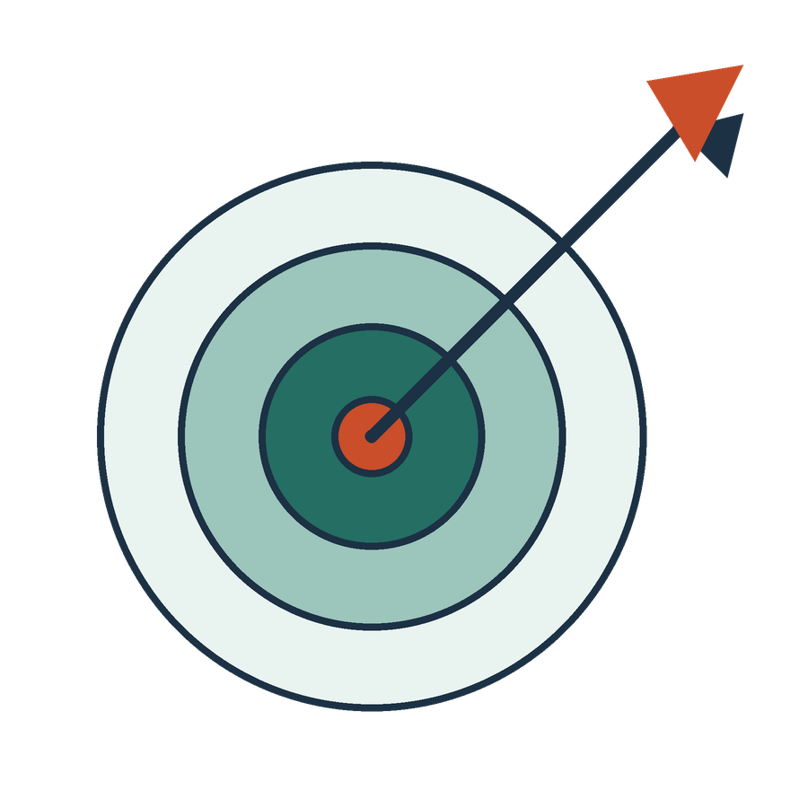
What we can conclude
APPLIED AI AND AUTOMATION 11
01
Privacy, professional confidentiality, quality and action authority are distinct risks. Each control needs an owner and a test. Incident response starts with containment and assessment, not a guessed universal reporting deadline.
02
The legal frame is a sourced teaching aid, not an opinion that a particular product or configuration complies.
KLAi Session 11 18
Notes:
Now let's see what the work supports. Before I read the conclusion, tell me in your own words what you think it is.
Here's what I'd say. Privacy, professional confidentiality, quality and action authority are separate risks. Each control needs an owner and a test. Incident response starts with containment and assessment, and it doesn't rely on a guessed universal reporting deadline.
There's also a limit. The legal frame we used is a sourced teaching aid. It's not an opinion that any particular product or configuration complies.
Tell me what you make of this. Which part of today's result is still unverified? Give that a little thought.
It's the legal frame. We haven't confirmed that any specific tool or setup complies, and a lawyer would need to review it with the facts. If you'd said everything is verified, I'd ask who has checked the Ugandan texts against our actual vendor contract.
Next is the firm decision itself.

Slide 19

The firm decision
APPLIED AI AND AUTOMATION 11
01
Approve a proportionate pilot policy and assign risk, information, technical and practice owners.
Record the decision and the evidence still needed.
KLAi Session 11 19
Notes:
Now the decision. The firm is deciding whether to approve a proportionate pilot policy, and to assign risk, information, technical and practice owners. It then records the decision and the evidence still needed.
A pilot is a small trial with limits. Proportionate means the controls match the risk of the use. Before we go on, name one owner and one condition. This is a class decision record, and the firm would still need its own authorisation.
One more question. What evidence would change this decision? Say it out loud if it helps.
Let me give you mine. If quality drops, if the permitted scope widens, or if a test fails, we revisit. The record itself holds the use, the evidence, the remaining risks, the conditions, an owner and a review date. If you'd said more testing, I'd ask which test, run by whom, with what result that would make you stop.

Slide 20

Check understanding
APPLIED AI AND AUTOMATION 11
01
No-training is enabled. What other data questions remain?
02
A scanned collection has more errors. What must be measured?
03
A restricted passage entered a draft. What is the first response?
KLAi Session 11 20
Notes:
Let's check your understanding with three changed facts. Answer each one aloud.
First. No-training is enabled. What other data questions remain? Take a moment with that.
I'd look at retention, access, contracts, location and permission.
Second. A scanned collection has more errors. What must be measured? Work it through before I answer.
I'd measure the quality and effects for the relevant groups, using samples large enough to mean something. How many pages from each group would you need before you trusted the comparison?
Third. A restricted passage has entered a draft. What's the first response? Think about that for a moment.
I'd contain the affected route, preserve the evidence, and assess the recipients and the duties.
That ends Session 11. Next time, in Session 12, we lead implementation and evaluate a pilot, using the owners and rules you drafted today.

Slide 21
Information and authority
APPLIED AI AND AUTOMATION 11
Concern | What the firm establishes
Client confidentiality | Permitted purpose, tool and disclosure
Personal data | Applicable obligations, access and handling
Privilege | Specific legal and factual assessment
Third-party content | Rights, licence and intended use
KLAi Session 11 21 OPTIONAL EXPLORATION
Notes:
Here's an optional extra for the time we have. It separates four concerns that people often merge. Client confidentiality asks for the permitted purpose, tool and disclosure. Personal data asks for the applicable obligations, access and handling. Privilege needs a specific legal and factual assessment. Third-party content turns on rights, licence and intended use. They can overlap, and one control doesn't answer all four.
Let me put a question to you. If we remove the names from a document, have we resolved every concern here? No rush.
The answer is no. The matter may still be sensitive, a person may still be identifiable from the facts, and professional duties remain. Here's a test. Could a reader work out the client from the deal terms alone?

Slide 22

Privacy and the organisation’s role
APPLIED AI AND AUTOMATION 11
01
Identify the purpose and data involved.
02
Establish responsibilities and provider arrangements.
03
Assess access, storage, transfers and retention.
04
Record required decisions and monitoring.
KLAi Session 11 22 OPTIONAL EXPLORATION
Notes:
This one is optional, for if we have time or you want it. It gives four steps for the privacy side of an organisation's role. Identify the purpose and the data involved. Establish responsibilities and provider arrangements. Assess access, storage, transfers and retention. Record required decisions and monitoring.
A public course like this one can't settle a particular firm's compliance position. That depends on its facts, and the firm's lawyers must decide it. The guidance from the data protection office is a local starting point.
Let me ask you something. Before we connect a client repository to an assistant, what should come first? Sit with it for a second.
I'd start with a documented purpose, and an assessment of the information and access, with the responsible people involved. If you'd said get the vendor's certificate, I'd ask which of the four steps a certificate covers.

Slide 23
Answer-quality risks
APPLIED AI AND AUTOMATION 11
Risk | Mitigation to test
Invented authority | Verify identity and supporting passage
Lost exception | Targeted clause tests and source review
Stale source | Version ownership and update tests
False confidence | Unanswerable questions and escalation
KLAi Session 11 23 OPTIONAL EXPLORATION
Notes:
This optional table sets four answer-quality risks against a mitigation to test. Invented authority calls for verifying the identity and the supporting passage. A lost exception calls for targeted clause tests and source review, like the Section 12.6 and Key Terms change in our agreement, where the original lets a party assign on notice and the Key Terms require prior written consent. A stale source calls for version ownership and update tests. False confidence calls for unanswerable questions and escalation.
Here's something to chew on. Which control addresses an old draft that is still indexed? See what you come up with.
Version controls, a source refresh and retrieval tests. If you'd said tell the model to use the newest, I'd ask how the system would know which one is newest.

Slide 24
Proportionate governance
APPLIED AI AND AUTOMATION 11
01
A public-source summary and a filing agent need different controls.
02
Higher consequences require stronger evidence and oversight.
03
Review controls when the use or authority changes.
KLAi Session 11 24 OPTIONAL EXPLORATION
Notes:
If we have time, there's an optional extra here. It is about proportion. A summary of public sources and an agent that files documents need different controls. Higher consequences need stronger evidence and oversight. And we review the controls when the use or the authority changes.
The aim is useful adoption with responsible limits. A single rigid process for every low-risk task wastes time. A senior user doesn't make a use low risk by being senior.
Now it's your turn. What raises the level of control a use needs? Have a think.
Sensitive data, consequential decisions, actions outside the firm, and wider autonomy for the system. If you'd only said sensitive data, I'd ask about a use with no sensitive data that sends an email to a client.

Slide 25
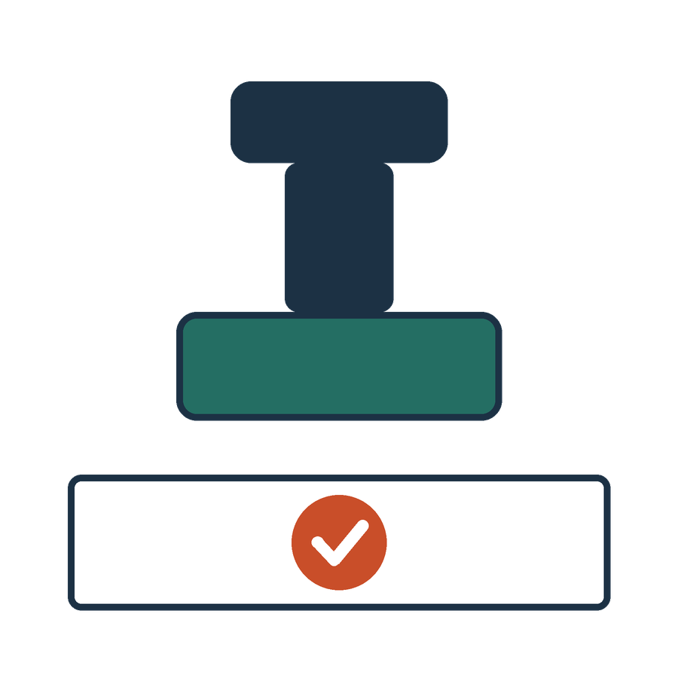
The partner’s governance decision
APPLIED AI AND AUTOMATION 11
01
Approve a limited use, require further work or stop.
02
Record why the evidence supports the decision.
03
Assign monitoring and the next review point.
KLAi Session 11 25 OPTIONAL EXPLORATION
Notes:
Here's an extra topic you can pick up if there's time. It gives the partner's decision three parts. Approve a limited use, require further work, or stop. Record why the evidence supports that choice. Assign monitoring and the next review point.
A question for you. What would an acceptable risk decision contain? Think it over.
It names the use, the evidence, the remaining risks, the conditions, an owner and a review date. It also says what is out of scope. If you'd only said approve, I'd ask what you would tell the associate who wants to know what they're now allowed to do.
That closes the optional set. Session 12 picks up the pilot.

